Slide 1


B.Tech Computer Science and Engineering – Vth Semester
Theory of Computation
Department of Computer Science and Engineering

Slide 2
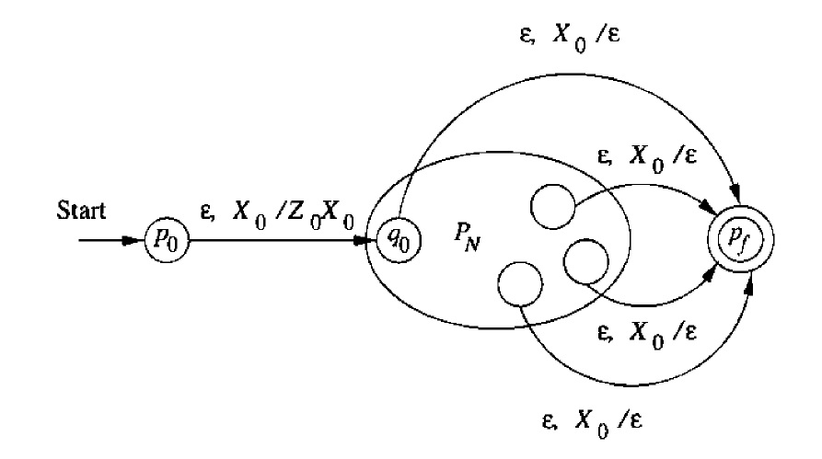
Empty stack to accepting state
From Empty stack to final state
If L=N(P_{N}) for some PDA P_{N}=(Q,∑,Γ,δ_{N,}q₀,Z₀) then there is a PDA P_{F}
The idea behind the proof

Slide 3
Proof Empty stack to accepting state
Here P_{F} simulates P_{N} and accepts if P_{N} empties its stack.
X₀ a new end marker, which is not a part of actual Γ is inserted to alarm that the stack is empty.
A new starting state p₀ that moves to the state q₀(starting state of P_{N}) by pushing the symbol X₀.
When the stack is empty then X₀ is exposed , then we move on to our new accepting state P_{f}. reading ε emptying the stack by poping X₀.

Slide 4

Proof Empty stack to accepting state
If we make the above changes the P_{N} will become P_{f}.
P_{f} =( QU{P₀P_{f}} , ∑ , ΓU{X₀}, δ_{F,} p₀, X₀, {P_{f}})
Compare this with
P_{N}=(Q,∑,Γ,δ_{N,}q₀,Z₀)
δ_{F} is defined by
δ_{F}(p₀,ε,X₀)={(q_{0,}Z₀ X₀)}
δ_{F}(q,a,Y) == δ_{N}(q,a,Y) for all state q in Q, and all input symbol in ∑
δ_{F}(q, ε, X₀) = (p_{F}, ε)

Slide 5
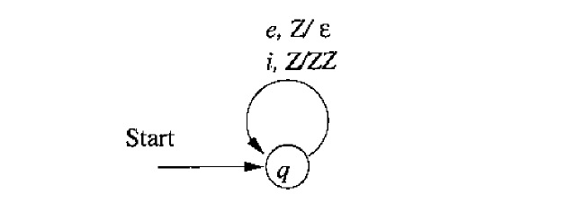
A PDA which accepts “if else” using empty stack
rule 1: push a 'Z' into the stack on reading a if
rule 2: pop 'Z' out of the stack on reading an else
rule 3: if the stack is empty it means that number of if s and else s are equal
if | Z
if | Z | Z
if | Z | Z | Z
else | Z | Z
else | Z
else | empty stack - hence accepted

Slide 6
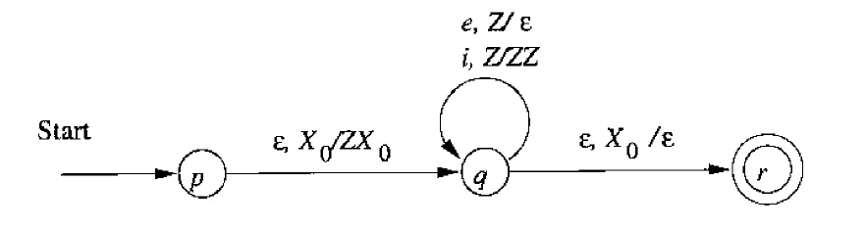
A PDA which accepts “if else” using accepting state (simulating empty stack)

Slide 7
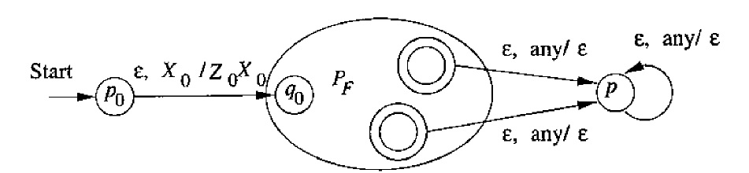
PDA – Accepting State to empty stack.

Slide 8
Thank You .. Have a Great Day

